Slide 1



Evaluation of Attack Tools against Open RAN Simulation Environments
Research Project, M.Sc. Communication Systems and Networks Presenter - Arnova Abdullah Supervisor - Professor Dr. Andreas Grebe

Slide 2
Contents
Objectives
5G Architecture
Theoretical Knowledge
Exploitation Tools Comparison
Atomic Red Team
Practical Work Implementation
Test Result Analysis
References
Conclusion & Future Works

Slide 3





Objectives
To investigate open-source attack tools for designing attacks against 5G Open RAN
To analyze vulnerabilities using the CVE database
To create attack traces as an inside attacker perspective for IT forensics to protect Open RAN

Slide 4





5G Architecture
Users
Cell site
RAN
Core
External Network
DU
AMF
UDM
NEF
UE
RU
CU
Private Network
SMF
NRF
SEPP
DU
UPF
UE
RU
Kubernetes
Kubernetes
Internet
OS
OS

Slide 5
Users
Cell site
RAN
Core
External Network
DU
AMF
UDM
NEF
UE
RU
CU
Private Network
SMF
NRF
SEPP
DU
UPF
UE
RU
Kubernetes
Kubernetes
Internet
OS
OS

Slide 6
Types of RAN
Radio Access Network
Centralized RAN (CRAN)
Distributed RAN (DRAN)
Open RAN (ORAN)
Virtualized RAN (vRAN)
Users
Cell site
RAN
Core
External Network
DU
AMF
UDM
NEF
UE
RU
CU
Private Network
SMF
NRF
SEPP
DU
UPF
UE
RU
Kubernetes
Kubernetes
Internet
OS
OS

Slide 7
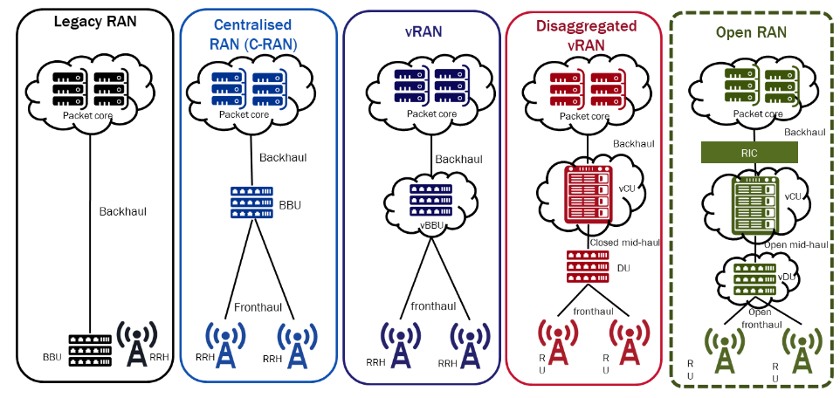
Types of RAN
Users
Cell site
RAN
Core
External Network
DU
AMF
UDM
NEF
UE
RU
CU
Private Network
SMF
NRF
SEPP
DU
UPF
UE
RU
Kubernetes
Kubernetes
Internet
OS
OS
[1]

Slide 8
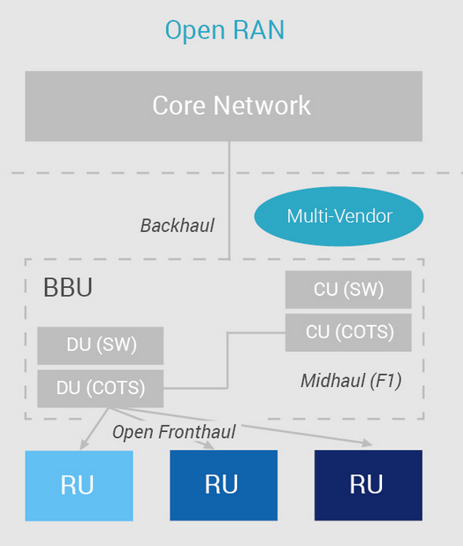
Open RAN (ORAN)
Users
Cell site
RAN
Core
External Network
DU
AMF
UDM
NEF
UE
RU
CU
Private Network
SMF
NRF
SEPP
DU
UPF
UE
RU
Kubernetes
Kubernetes
Internet
OS
OS
[2]

Slide 9

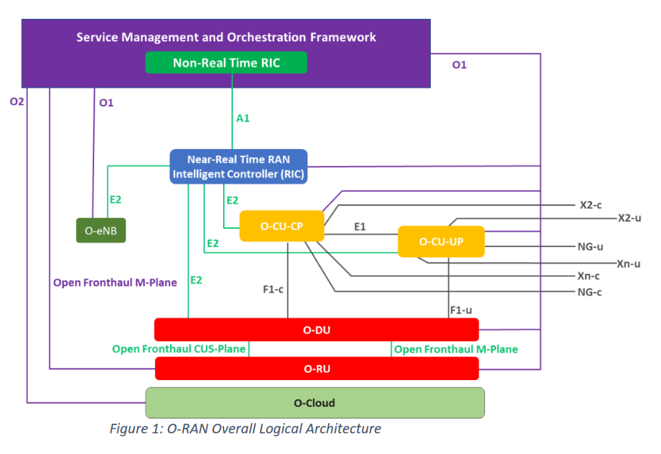
Open RAN
[3]
A multi-supplier RAN solution that
allows for the separation - or disaggregation - between hardware and software
with open interfaces and virtualization, hosting software
Components:
Near Real-time RIC
Non-real-time RIC
A1 interface
E2 simulator
[3]

Slide 10
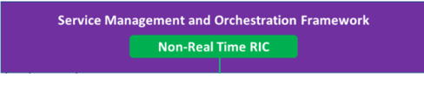

Open RAN
A multi-supplier RAN solution that
allows for the separation - or disaggregation - between hardware and software
with open interfaces and virtualization, hosting software
Components:
Near Real-time RIC
Non-real-time RIC
A1 interface
E2 simulator
[3]
Notes:
The main purpose of RIC is to automate and optimize the RAN at scale, with the end goal of reducing the mobile operator’s total cost of ownership. A Non-Real Time RIC is an Orchestration and Automation function described by the O-RAN Alliance. Near-RT RIC is a logical function that enables near-real-time optimization and control and data monitoring of O-CU and O-DU nodes in near-RT timescales. The Near-RT RIC controls RAN elements and their resources with optimization actions that typically take 10 milliseconds to one second to complete. It receives policy guidance from the Non-RT RIC and provides policy feedback to the Non-RT RIC through specialized applications called xApps.

Slide 11
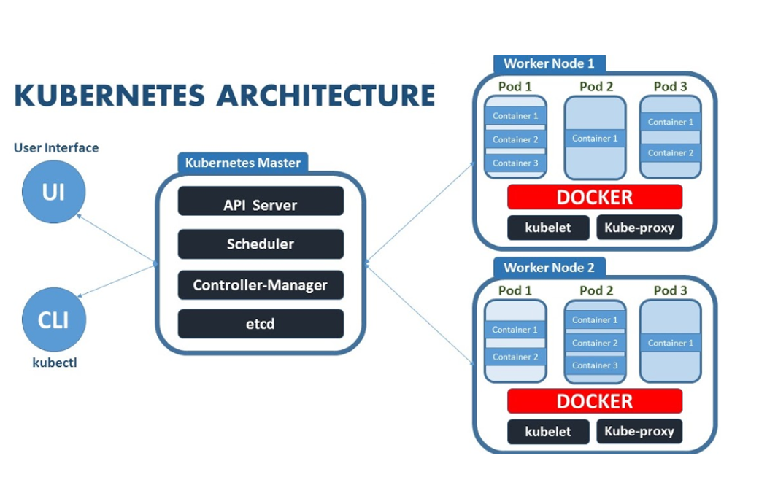
Users
Cell site
RAN
Core
External Network
DU
AMF
UDM
NEF
UE
RU
CU
Private Network
SMF
NRF
SEPP
DU
UPF
UE
RU
Kubernetes
Kubernetes
Internet
OS
OS
[4]

Slide 12
CVE
Stands for Common Vulnerabilities and Exposures
A reference method for publicly known information-security vulnerabilities and exposures.
CVE Identifier defined by MITRE Corporation.
To search for known vulnerabilities by vendor, product, or version,
user-friendly website https://www.cvedetails.com/ [5]

Slide 13
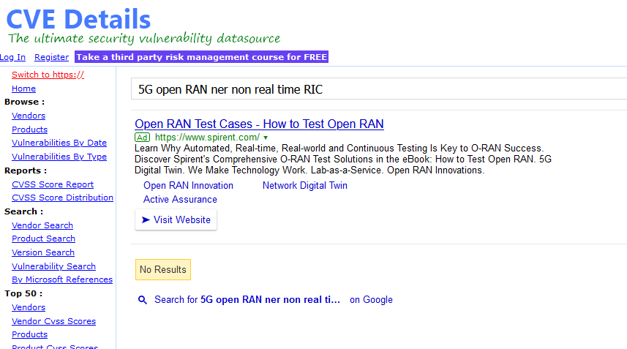
Searching Vulnerability for Open RAN in CVE Database
Users
Cell site
Open RAN
Core
External Network
DU
AMF
UDM
NEF
UE
RU
CU
Private Network
SMF
NRF
SEPP
DU
UPF
UE
RU
Kubernetes
Kubernetes
Internet
OS
OS
[5]

Slide 14
Searching Vulnerability for Open RAN in CVE Database
Last accessed in March 2023 !!
Users
Cell site
Open RAN
Core
External Network
DU
AMF
UDM
NEF
UE
RU
CU
Private Network
SMF
NRF
SEPP
DU
UPF
UE
RU
Kubernetes
Kubernetes
Internet
OS
OS
[5]

Slide 15
Users
Cell site
RAN
Core
External Network
DU
AMF
UDM
NEF
UE
RU
CU
Private Network
SMF
NRF
SEPP
DU
UPF
UE
RU
Kubernetes
Kubernetes
Internet
OS
OS

Slide 16
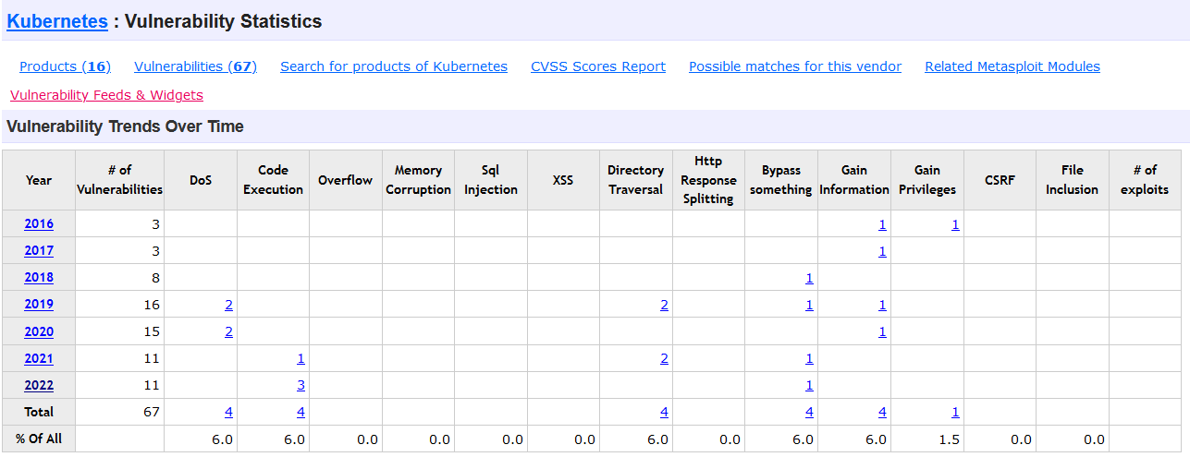
Users
Cell site
RAN
Core
External Network
DU
AMF
UDM
NEF
UE
RU
CU
Private Network
SMF
NRF
SEPP
DU
UPF
[5]
Searching Vulnerability for Kubernetes in CVE Database
UE
RU
Kubernetes
Kubernetes
Internet
OS
OS

Slide 17
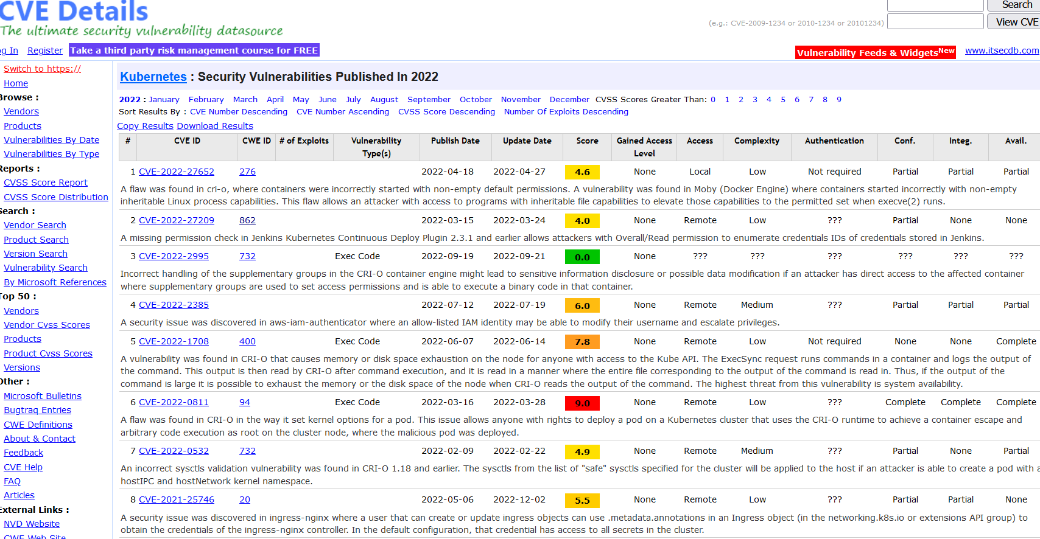
Last accessed in March 2023 !!
Users
Cell site
RAN
Core
External Network
DU
AMF
UDM
NEF
UE
RU
CU
Private Network
SMF
NRF
SEPP
DU
UPF
[5]
Searching Vulnerability for Kubernetes in CVE Database
UE
RU
Kubernetes
Kubernetes
Internet
OS
OS

Slide 18
CVE ID
Idea: Test the system by exploiting with CVE ID
Users
Cell site
RAN
Core
External Network
DU
AMF
UDM
NEF
UE
RU
CU
Private Network
SMF
NRF
SEPP
DU
UPF
UE
RU
Kubernetes
Kubernetes
Internet
OS
OS

Slide 19
CVE ID
Idea: Test the system by exploiting with CVE ID
Users
Cell site
RAN
Core
External Network
DU
AMF
UDM
NEF
UE
RU
CU
Private Network
Which open-source exploitation tools are available?
SEPP
SMF
NRF
DU
UPF
UE
RU
Kubernetes
Kubernetes
Internet
OS
OS

Slide 20

Attack Tools - Evaluation and Comparison
Atomic Red Team
Kali Linux
Caldera
Infection Monkey
[6]
[7]
[8]
[9]

Slide 21
Attack Tools - Evaluation and Comparison
Aspect | Kali Linux | Infection Monkey | Atomic Red Team | Caldera
Purpose | Penetration testing | Breach and Attack simulation | Adversary Attack emulation | Cyber Adversary Language and Decision Engine for Red Team Automation
Testing Capabilities | 600 pre-installed tools | Network-based attack, results mapped to MITRE ATT&CK | Attack tests mapped to MITRE ATT&CK | Attack tests mapped to MITRE ATT&CK
Source | Open-source OS | Open-source by Akamai (however it is associated with AWS platform) | Open-source Github project by Red Canary | Open-source Github project by Red Canary
Test Coverage | Diverse test suite | Network-based attacks | Specific atomic tests | Tactic-based simulation
User Interface | GUI, command line interface | GUI | Command line interface | Command line interface
CVE Mapping tests | Vulmap tool test result mapped to CVE | Result report mapped to MITRE, so CVE mapping possible to the result | Attack test mapping to CVE possible | Attack test mapping to CVE possible

Slide 22
Attack Tools - Evaluation and Comparison
Aspect | Kali Linux | Infection Monkey | Atomic Red Team | Caldera
Purpose | Penetration testing | Breach and Attack simulation | Adversary Attack emulation | Cyber Adversary Language and Decision Engine for Red Team Automation
Testing Capabilities | 600 pre-installed tools | Network-based attack, results mapped to MITRE ATT&CK | Attack tests mapped to MITRE ATT&CK | Attack tests mapped to MITRE ATT&CK
Source | Open-source OS | Open-source by Akamai (however it is associated with AWS platform) | Open-source Github project by Red Canary | Open-source Github project by Red Canary
Test Coverage | Diverse test suite | Network-based attacks | Specific atomic tests | Tactic-based simulation
User Interface | GUI, command line interface | GUI | Command line interface | Command line interface
CVE Mapping tests | Vulmap tool test result mapped to CVE | Result report mapped to MITRE, so CVE mapping possible to the result | Attack test mapping to CVE possible | Attack test mapping to CVE possible

Slide 23

Atomic Red Team
A library of tests mapped to the framework.
[10]

Slide 24
Atomic Red Team
A library of tests mapped to the framework.
Adversarial Tactics, Techniques, and Common Knowledge

Slide 25
Atomic Red Team
A library of tests mapped to the framework.
To run an atomic test, it requires MITRE ID.

Slide 26
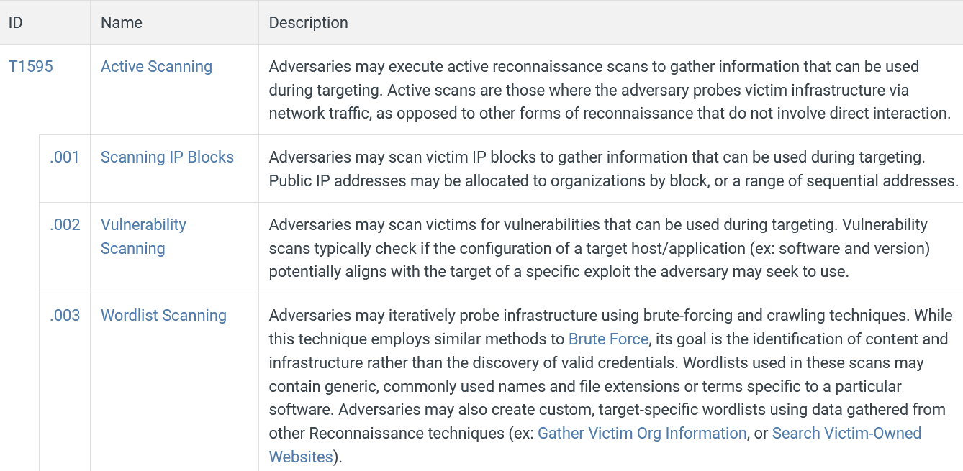
Atomic Red Team
A library of tests mapped to the framework.
To run an atomic test, it requires MITRE ID.
[10]

Slide 27
Atomic Red Team
A library of tests mapped to the framework.
To run an atomic test, it requires MITRE ID.
Atomic tests are available for Windows, Linux, and macOS

Slide 28
Atomic Red Team
A library of tests mapped to the framework.
To run an atomic test, it requires MITRE ID.
Atomic tests are available for Windows, Linux, and macOS
Execution framework: Invoke-Atomic
Powershell module to automatically run the tests with MITRE ID.
To use this framework on Linux and macOS, Powershell Core is required.

Slide 29
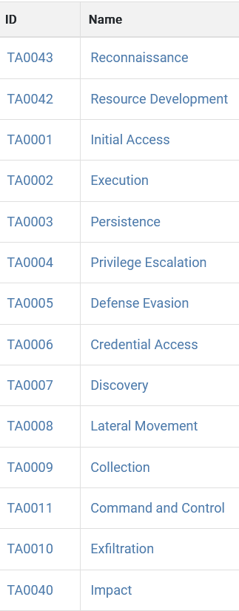
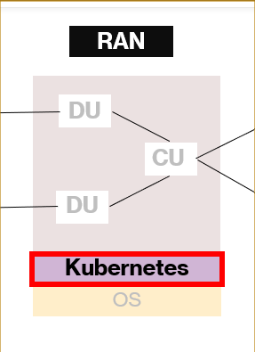
Practical Work - Proposed Attack Architecture
Three phases of practical work -
Mapping between CVE ID and MITRE ID
Open Ran implementation in the Kubernetes environment
Atomic test implementation
CVE ID
MITRE ID
RAN
Atomic test 1
Atomic test 2
Atomic test 3

Slide 30

Practical Work
Phase 1: Mapping between CVE ID to MITRE ID
CVE ID
MITRE ID
RAN
Atomic test 1
Atomic test 2
Atomic test 3

Slide 31
Practical Work
Phase 2: Open RAN implementation in the Kubernetes environment
CVE ID
MITRE ID
RAN
Atomic test 1
Atomic test 2
Atomic test 3

Slide 32
Practical Work
Phase 3: Atomic test implementation
CVE ID
MITRE ID
RAN
Atomic test 1
Atomic test 2
Atomic test 3

Slide 33
Mapping between CVE and MITRE - Phase 1
Vulnerability
allows
Exploitation technique
enables
Primary impact
leads to
Secondary impact
Following an open-source Github project [11]
Methodology broken into 3 steps
One CVE ID can be mapped to one or several MITRE IDs

Slide 34
Mapping between CVE and MITRE - Phase 1
CVE-2022- 3294
T1548.002
T1056
T1005
T1496
T1119
T1489
T1529
T1537
CVE-2022-3294
A bug in kube-apiserver made it possible to bypass validation. Bypassing this validation could allow authenticated requests destined for Nodes to the API server's private network.

Slide 35
Mapping between CVE and MITRE - Phase 1
Exploitation technique
CVE-2022- 3294
T1548.002
T1056
T1005
T1496
T1119
T1489
T1529
T1537
CVE-2022-3294
A bug in kube-apiserver made it possible to bypass validation. Bypassing this validation could allow authenticated requests destined for Nodes to the API server's private network.
T1548.002
Abuse Elevation Control Mechanism: Bypass User Account Control.

Slide 36
Mapping between CVE and MITRE - Phase 1
CVE-2022- 3294
T1548.002
T1056
T1005
T1496
T1119
T1489
T1529
T1537
CVE-2022-3294
A bug in kube-apiserver made it possible to bypass validation. Bypassing this validation could allow authenticated requests destined for Nodes to the API server's private network.
T1056
Capturing user input to obtain credentials or collect information.
Primary Impact

Slide 37
Mapping between CVE and MITRE - Phase 1
CVE-2022- 3294
T1548.002
T1056
T1005
T1496
T1119
T1489
T1529
T1537
CVE-2022-3294
A bug in kube-apiserver made it possible to bypass validation. Bypassing this validation could allow authenticated requests destined for Nodes to the API server's private network.
T1529
Adversaries may shut down/reboot systems to interrupt access to the systems.
Secondary Impact

Slide 38
Mapping between CVE and MITRE - Phase 1
CVE ID | Vulnerability Type | Exploitation Technique | Primary Impact | Secondary Impact | Technology and Year
CVE-2022-3294 | Bypass of Proxy Address Validation in kube apiserver | T1548.002 | T1056, T1005, T1119 | T1496, T1489, T1529, T1537 | Kubernetes, 2022
CVE-2022-3162 | Unauthorized Access to Custom Resources in the Same API Group | T1040 | T1078 | N/A | Kubernetes, 2022
CVE-2021-25743 | Unneutralized Escape Sequences in Kubectl Output | T1219 | T1565 | N/A | Kubernetes, 2021
CVE-2020-8562 | Proxy Bypass to Access Private Networks | T1548.002 | T1590.002 | N/A | Kubernetes, 2020

Slide 39
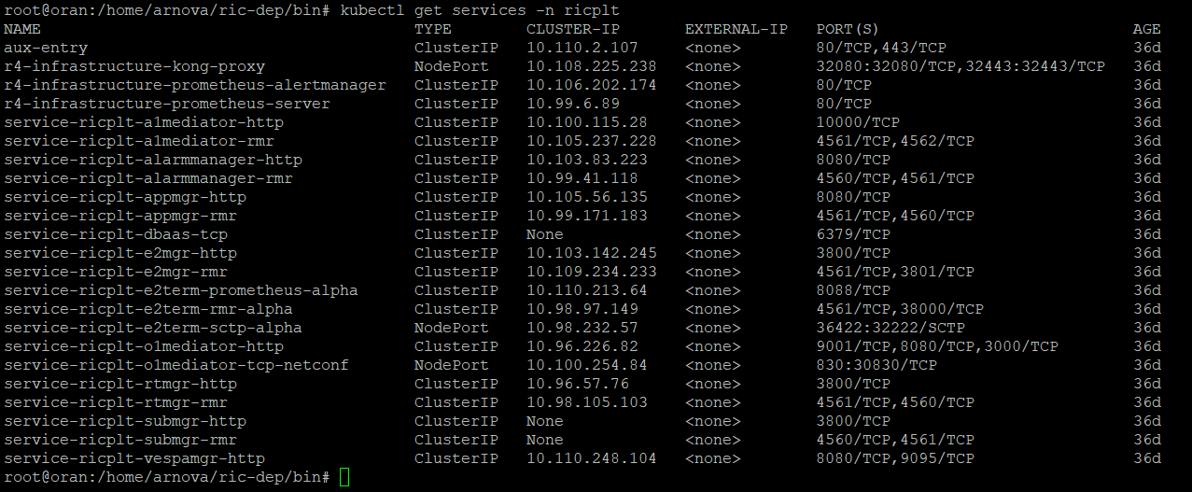
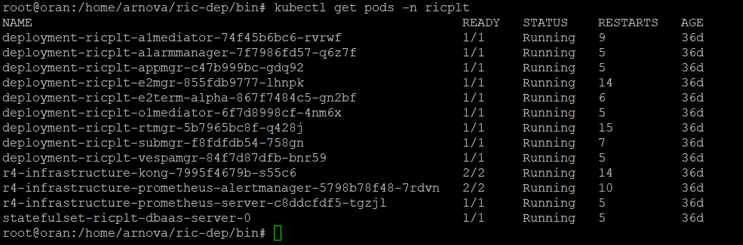
Open RAN Implementation - Phase 2
Near real-time RIC of Open RAN
implemented in Kubernetes pods and services in Computer Network Research Laboratory, TH Köln
Installed services

Slide 40
Open RAN Implementation - Phase 2
Near real-time RIC of Open RAN
implemented in Kubernetes pods and services in Computer Network Research Laboratory, TH Köln
Installed Pods

Slide 41



Atomic Attack Implementation - Phase 3
Local Test
Remote Test
SSH session

Slide 42

Atomic Attack Implementation - Phase 3
Local Test
Remote Test
SSH session
Attack from inside the network!!

Slide 43
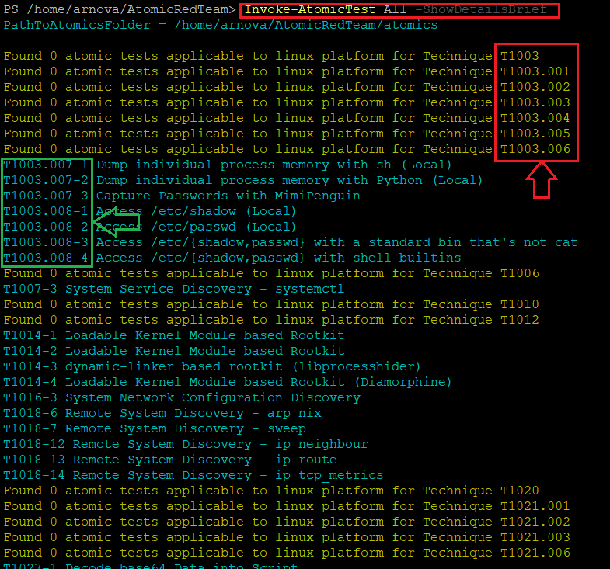
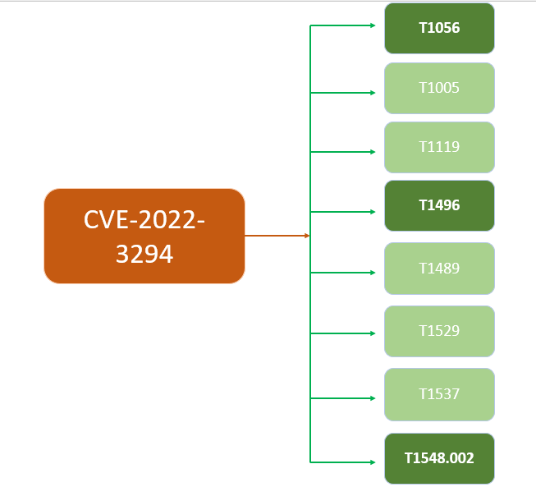
Atomic Attack Implementation - Phase 3
Availability: Some attack tests were unavailable due to unsupported OS

Slide 44
Atomic Attack Implementation - Phase 3
Availability: Some attack tests were unavailable due to unsupported OS

Slide 45
Atomic Attack Implementation - Phase 3
Local Test
Due to the difficulty to create an SSH session, the local test has been selected!!

Slide 46
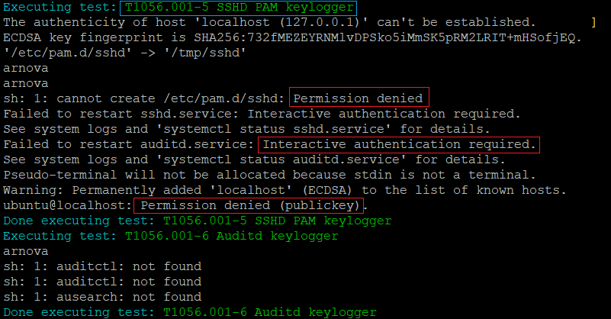
Result Analysis - Atomic test report
Test number: T1056.001 - Atomic Test #5
Test name: SSHD PAM Keylogger
Description: Evaluates an organization's ability to detect and respond to keylogging attacks on SSH authentication.
Result Analysis: A failure to create or modify the file due to permission denied.

Slide 47
Result Analysis - Atomic test report
Test number: T1056.001 - Atomic Test #5
Test name: SSHD PAM Keylogger
Description: Evaluates an organization's ability to detect and respond to keylogging attacks on SSH authentication.
Result Analysis: A failure to create or modify the file due to permission denied.

Slide 48
Result Analysis - Atomic test report
Test number: T1056.001 - Atomic Test #5
Test name: SSHD PAM Keylogger
Description: Evaluates an organization's ability to detect and respond to keylogging attacks on SSH authentication.
Result Analysis: A failure to create or modify the file due to permission denied.

Slide 49

Result Analysis - Atomic test report summary
Test Number | Test Name | Test Result Analysis | Security of Open RAN simulation
T1078.003 | Valid Accounts: Local Accounts | Permission Denied
T1496 | Resource Hijacking | Time out after 120 seconds preventing processes from consuming excessive resources
T1529 | System Shutdown/Reboot | Permission Denied
T1548.001 | Abuse Elevation Control Mechanism: Setuid and Setgid | Permission Denied
T1611 | Escape to Host | Permission Denied
T1613 | Container and Resource Discovery | Permission Denied

Slide 50

Conclusion
This project was successful to provide the Proof of Concept (PoC)
A suitable adversary emulation tool “Atomic Red Team” was selected for securing 5G Open RAN near real-time RIC against attackers from inside the network
Attack tests based on known vulnerabilities by mapping CVE ID to MITRE ID were implemented conveniently.
Limitation:
Mapping CVE to MITRE can be different for different people.
Not all the MITRE IDs were available so we can not ensure whether the system is totally secure against a specific CVE ID.
Depending on a specific CVE ID could be unfeasible because not every CVE ID is implemented.

Slide 51
Future Works
Expand the evaluation framework by including other attack stakeholders
Investigate implementing automation and orchestration techniques for the security tests
Extend project scope beyond Kubernetes to include operating systems and virtualization technologies
Explore integration of other open-source security tools to enhance threat detection

Slide 52
References
https://www.ericsson.com/495e28/assets/local/future-technologies/doc/ericsson-open-ran-operators-perspective.pdf
https://www.detecon.com/en/journal/open-ran-opportunities-and-challenges-telcos
https://www.o-ran.org/resources [O-RAN Alliance]
https://dockerlabs.collabnix.com/kubernetes/beginners/what-is-kubernetes/
https://www.cvedetails.com/ [CVE Database]
https://atomicredteam.io/ [Atomic Red Team]
https://www.kali.org/ [Kali Linux]
https://www.akamai.com/infectionmonkey [Infection Monkey]
https://caldera.mitre.org/ [Caldera]
https://attack.mitre.org/ [MITRE ATT&CK Framework]
https://github.com/center-for-threat-informed-defense/attack_to_cve [CVE mapping to MITRE]

Slide 53
Thank You!
Question?
Contact: arnova.abdullah@smail.th-koeln.de
Tools used | Purpose | Version
Ubuntu | Operating System | 20.04 LTS
Atomic Red Team | Adversary Emulation | -
Kubernetes | Container Orchestration | V1.16
Kali Linux | Operating System | 2023.1

Slide 54
Extra slides - MITRE ID
Primary impact:
T1005: Adversaries may search local system sources, such as file systems and configuration files or local databases, to find files of interest and sensitive data prior to Exfiltration.
T1119: Automated collection, Once established within a system or network, an adversary may use automated techniques for collecting internal data.
Secondary impact:
T1489: Adversaries may stop or disable services on a system to render those services unavailable to legitimate users.
T1537: Adversaries may exfiltrate data by transferring the data, including backups of cloud environments, to another cloud account they control on the same service to avoid typical file transfers/downloads and network-based exfiltration detection.
T1496: Resource hijacking, Adversaries may leverage the resources of co-opted systems in order to solve resource-intensive problems, which may impact system and/or hosted service availability.

Slide 55
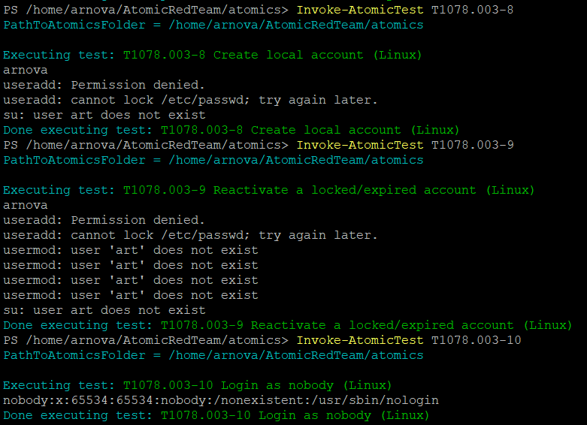
Atomic tests
Test number: T1078.003-8
Test name: Valid accounts, local accounts
Result: Permission denied

Slide 56
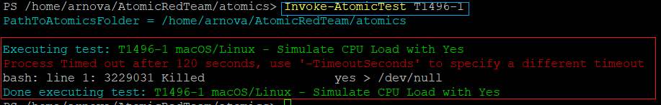
Atomic tests
Test number: T1496-1
Test name: Resource hijacking
Result: Time out after 120 seconds

Slide 57
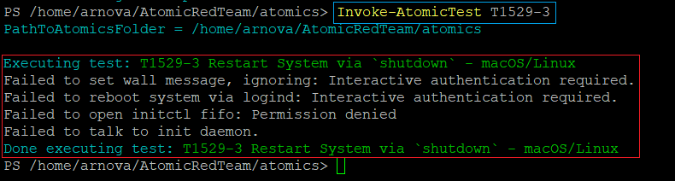
Atomic tests
Test number: T1529-3
Test name: System Shutdown/Reboot
Result: Permission denied

